Slide 1
Data Mining
BY
Adnan Amin
Lecturer, IMSciences, Peshawar
adnan.amin@imsciences.edu.pk

Slide 2
Outlines
Recap: Supervised Learning
Understanding NN Matching.
What’s KNN?
How does KNN works?
Eager vs Lazy learners
Curse of dimensionality
Hyperparameter

Slide 3
Recap: Supervised Learning
The supervised learning algorithm will learn the relation between training examples and their associated target variables, then apply that learned relationship to classify entirely new inputs (without targets).
For example:
In the same way a teacher (supervisor) would give a student homework to learn and grow knowledge, supervised learning gives algorithms datasets so it too can learn and make inferences.
Source: https://builtin.com/data-science/supervised-learning-python

Slide 4
Recap: Supervised Learning
let’s consider an example of predicting the marks of a student based on the number of hours he studied.
Mathematically,
Y = f(X)+ C
f will be the relation between the marks and number of hours the student prepared for an exam.
X is the INPUT (Number of hours he prepared).
Y is the output (Marks the student scored in the exam).
C will be a random error.
The ultimate goal of the supervised learning algorithm is to predict Y with the maximum accuracy for a given new input X.
Source: https://builtin.com/data-science/supervised-learning-python

Slide 5
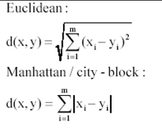
Prerequisites
Distance measures

Slide 6
Understanding Nearest Neighbour
This method relies on identifying the Kth (let k=3) instances that are ‘closest’ in some sense to an unclassiﬁed one.
If the 3 ‘nearest neighbours’ have class label Second, First, Second.
We might reasonably conclude that the new instance should be classiﬁed as ‘Second’. (Majority Voting)
1. Choose the number of k and a distance metric.
2. Find the k nearest neighbors of the sample that we want to classify.
3. Assign the class label by majority vote.
Column | Class
Data | Second
Data | First
Data | Second
Data | ?

Slide 7
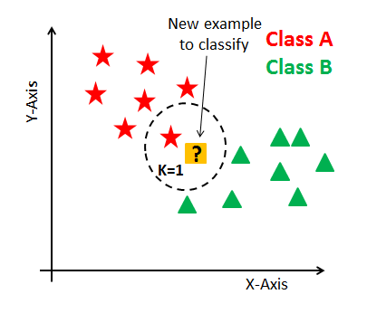
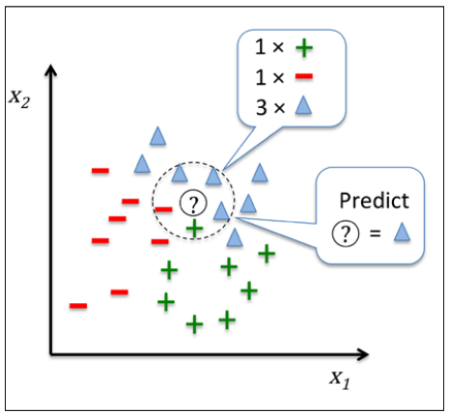
What’s KNN?
KNN is a non-parametric and lazy learning algorithm.
K is the number of nearest neighbors.
Non-parametric means there is no assumption for underlying data distribution.
e.g., the model structure determined from the dataset. And do not follow mathematical theoretical assumptions.
Lazy algorithm means it does not need any training data points for model generation. All training data used in the testing phase.
K is core deciding factor. Usually, k is set to be odd number.

Slide 8
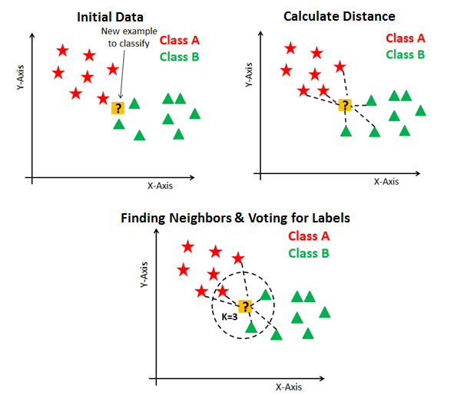
How does KNN works?
Three step process:
Calculate distance
Find closest neighbors
Vote for labels
Suppose P1 is the point, for which label needs to predict.
find the k closest point to P1 and then classify points by majority vote of its k neighbors.
Each object votes for their class and the class with the most votes is taken as the prediction.
K closest point: distance between points using distance measures such as Euclidean distance, Hamming distance, Manhattan distance and Minkowski distance
Source. DataCamp.com

Slide 9
Eager vs Lazy Learning Algorithms
Eager
Construct a generalized model from a given dataset before performing prediction on given new points to classify.
Then ready/eager to classify unobserved data points.
Lazy
No need for learning or training of the model and all of the data points used at the time of prediction.
Do less work in the training phase and more work in the testing phase to make a classification.
Required time and memory.
Also known as instance-based learners, because learning is based on stored instances.
Curse of Dimensionality
Source. DataCamp.com

Slide 10
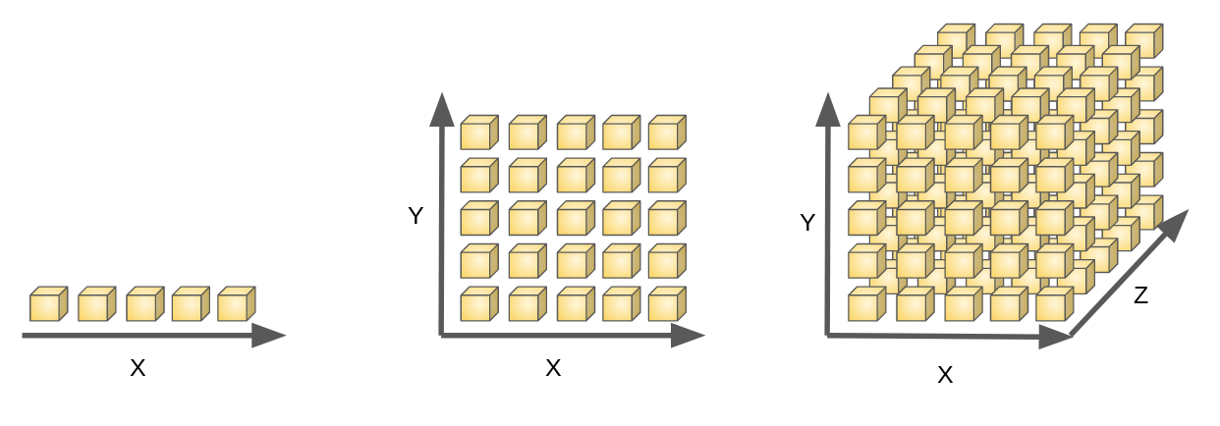
Curse of Dimensionality
Increase in dimension also leads to the problem of overfitting.
This problem of higher dimension is known as the Curse of Dimensionality.
For example:
KNN performs better with a lower number of features than a large number of features.
When the number of features increases than it requires more data.
“A set of problems that arise when working with high-dimensional data.”

Slide 11
Solution
To deal with the problem of the curse of dimensionality, you need to perform principal component analysis (PCA) before applying any machine learning algorithm, or you can also use feature selection approach. Research has shown that in large dimensions Euclidean distance is not useful anymore. Therefore, you can prefer other measures such as cosine similarity, which get decidedly less affected by high dimension.
Source. DataCamp.com

Slide 12
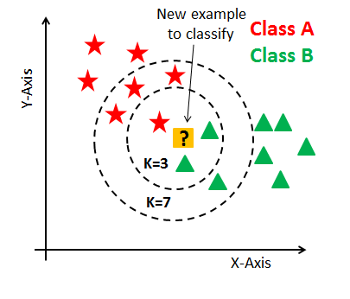
Hyperparameter?
How to choose the optimal number of neighbors (value of K)?
Research has shown that no optimal number of neighbors suits all kind of data.
The number of neighbors (K) in KNN is a hyperparameter that you need choose at the time of model building.
K as a controlling variable for the prediction model.
A small amount of neighbors are most flexible fit.

Slide 13
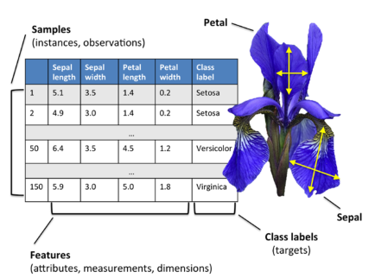
IRIS DATASET
Problem:
How to CLASSIFY THE TYPE OF FLOWER BASED ON THE GIVEN INPUT
Download DATASET
URL: https://archive.ics.uci.edu/ml/datasets/iris
Source: Python Machine Learning by Sebastian
https://builtin.com/data-science/supervised-learning-python

Slide 14
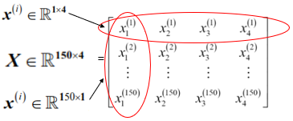
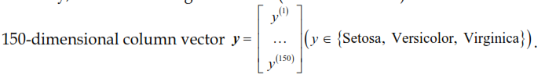
IRIS DATASET…
Basics of linear algebra:
The Iris dataset contains the measurements of 150 iris flowers from three different species: Setosa, Versicolor, and Viriginica.
We will use a matrix and vector notation to refer to our data.
The Iris dataset, consisting of 150 samples and 4 features, can then be written as a 150x4 matrix,
The target variables

Slide 15
IMPLEMENTING KNN IN SCIKIT-LEARN ON IRIS DATASET
Before getting started, make sure you install the following python packages using pip.
pip install pandas
pip install matplotlib
pip install scikit-learn

Slide 16
Thank You!
Book: Python Machine Learning by Sebastian
URL: https://builtin.com/data-science/supervised-learning-python
Article and source code available online:
Visit: adnan-amin.medium.com

